Slide 1



Legacies of failure to win the City of Culture: Identity, civicism and change
Dr Annmarie Ryan, Lecturer in Marketing, Kemmy Business School, University of Limerick
Professor Gayle McPherson, Professor in Events and Cultural Policy, University of the West Scotland

Slide 2

Context
The European Capital of Culture Programme and the UK Cities of Culture Programme have emerged as important vehicles in the realisation of the promise of culture led regeneration (see Balsas, 2004 and the work of Garzia, e.g. 2004, 2004b, 2005).
The Capital/City of Culture title focuses on a single place generally with deep social, economic and educational inequalities and allows cities to invest in the belief that arts, culture and heritage development will be transformative in social and economic growth.
The value of bidding both in terms of cultural value and public value is well documented (Crossick, & Kaszynska, 2016 and the Warwick Commission report, 2015; Bozeman and Johnson, 2015) but less so is evidence on those cities that fail to win and the concomitant impact this has on the town/city.
This paper is premised on the position that losing the bid to host a cultural mega event is a legitimate position which when recognised as such can enable the study of the methodologies cities employ as part of their bid process as an important area of study in its own right.

Slide 3

Conceptual Framing
ILLUSTRATION BY CHRIS BUZELLI
We conceive of the bidding phase of a competitive cultural mega event competition as a liminal space; where the old rules of cultural organising are put into flux, and where novel or creative solutions can be re-imagined
The liminal quality of the bid phase plays a role in the mobilisation and enrolment of key multi-agency actors required by the bid process to be involved (e.g. community and civic groups, the business community, elected local politicians, members of the cultural community/artists)
We argue that civic pride has a specific role to play during the competitive bid process, often where regional and national rivalries will be animated to encourage participation in the bid process

Slide 4
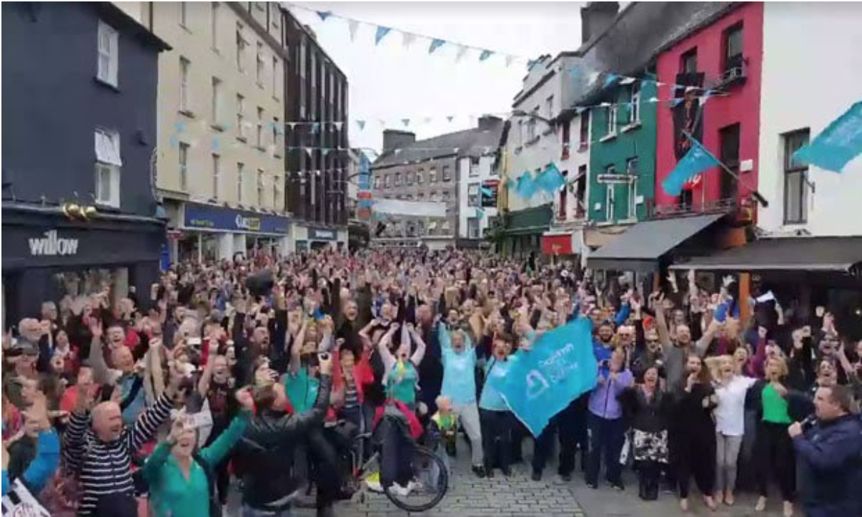
Bell, et al. (2013 pg 4) offer the term Civicism to express the sentiment of urban pride, which we argue comes into stark relief, and even alteration, during a city’s attempt to host a cultural mega event.
According to Bell (2013), citizen (or 'city-zens' as they remark) take special pride not just in the fact that they live in an urban environment with characteristics that make that desirable compared to, for example, rural life but also that they take special pride in the fact that they live in an urban environment that is special relative to other cities.

Slide 5
Method and Cases
The research fieldwork adopted a qualitative approach
Data collection included:
participant observation data,
semi-structured interviews, 30-60mins each, have been conducted with key members of the bid team and community organisations
The authors also had access to secondary data such as policy documents, digital media analysis

Slide 6
Bid process as liminal
 | Core concept | Limerick | Paisley
Bid and aftermath as Liminal Space
Heightened sense of now | ‘You forget about everything else’; ‘you concentrate only on what is happening here’ (Van Heerden pg 137) | Awareness of deadlines and preparations for submission at various stages in the process | Why I love Paisley campaign and subsequently Paisley Is
Altered routines | Bracketing off a time where minor and major transgressions of various established routines and behaviour are permissible. | New committees, open workshops, citizen engagement and invitation of new cultural expertise specific for the bid process | CHF allowed bidding to create new cultural gatherings in neighbourhoods and festivals - outside of the routine
re-discover/re-appropriation of public spaces | Space is encoded with different over-laying meanings compared to the ways in which it was usually conceived, thereby altering its utilization. | New areas of the city re-purposed for civic cultural events (e.g main street) | Hidden heritage was mapped, cultural assets previously disbanded, but groups rediscovered too
Re-working of rules | Victor Turner (1974: 13-14), “in this gap between ordered worlds [in other words during liminality] almost anything may happen”. | Expansion of the city’s culture team, new arts strategy co-developed with the sector | Moving on from paisley’s strong cultural past to create a new vision for cultural heritage in paisley
From Turner (1974) and developed developed by Van Heerden (2011)

Slide 7
Supported by/shaping Civicism
“Who we are/who we are not” (after Bell, Czarniawska, citing Tarde)
‘we are very proud of it… people brought up memories from 40-50 years ago and
wanted people see Paisley like that again’ (Alan McNiven Create Renfrewshire, 2019).
“Very Proud of the sense of togetherness felt in
#Limerick today #Limerick2020” @LimerickCitybiz
“Massive well done to all involved.
Limerick city is smiling #Limerick2020 #limerickandproud” coffee shop owners
“@GalwayPlayer we’ll whip Galway’s arse ;) #Limerick2020” @Laurhayes

Slide 8
Legacy Effects
“the foregrounding of the Arts, of Culture in planning in the city. And part, that then it would become part of our identity. And I thought that was a really big shift from the first time it was applied for” (Ciarda, Limerick team)
“We would still be tinkering around the edges of probably more heritage projects that were a bit more piecemeal on an individual basis but the Paisley untold strategy and bid has helped us to justify why we would invest in cultural assets and programmes” (Stuart, bid manager, 2019).
“Its only the bidding cities that did a cultural strategy, all the other arts offices are still writing arts plans. The cultural strategy is really long binding, like, it’s not a three-year plan. The arts plans, a lot of them are very much like work programmes, whereas the cultural strategy we have eight aims and objectives and it’s gone right the way up to 2030” (Pippa, arts officer, LCC)

Slide 9
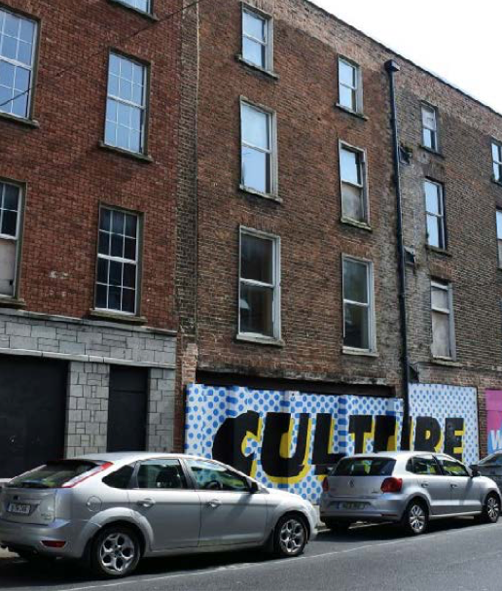
Discussion/Conclusion
For both cities not winning has allowed them to be more creative with time, but will also, importantly be a site for contestation, in the bid process in particular issues are not yet ‘settled’, but in a process of becoming and evolving as progressive opportunities.
Being out of the spotlight now allows both authorities the chance to deliver a programme each can engage in and further reflect and develop on their own terms. They have both managed to successfully bring on further European and International partners as we have discussed above, whilst securing local and national funding to develop their step changes and goals.
The bid process is clearly significant, working to shape and reshape the city during a potent liminal time. Feather understanding of this performative aspect of the bid process is required.

Slide 10
Legacies of failure to win the City of Culture: Identity, civicism and change
Dr Annmarie Ryan, Lecturer in Marketing, Kemmy Business School, University of Limerick
Professor Gayle McPherson, Professor in Events and Cultural Policy, University of the West Scotland

